Slide 1
Digital Portfolio
STUDENT NAME: RESHMA.A
REGISTER NO AND NMID: asbru3j2428b0240 AND 09981AEA823F9978C2B4CF08CA72B2DE
DEPARTMENT: B.SC COMPUTER SCIENCE WITH DATA ANALYTICS
COLLEGE/UNIVERSITY:TIRUPPUR KUMARAN COLLEGE FOR WOMEN/
BHARATIYAR UNIVERSITY COIMBATORE

Slide 2
PROJECT TITLE
CLOUD COMPUTING

Slide 3


AGENDA
Problem Statement
Project Overview
End Users
Tools and Technologies
Portfolio design and Layout
Features and Functionality
Results and Screenshots
Conclusion
Github Link
3/21/2024 Annual Review

Slide 4

PROBLEM STATEMENT
Traditional IT systems face challenges in scalability, cost, and security. Cloud computing is needed to provide flexible, secure, and cost-efficient access to resources on demand.

Slide 5

PROJECT OVERVIEW
This project focuses on leveraging cloud computing to provide scalable, secure, and cost-effective solutions for data storage and application deployment. Using cloud services, the project enables on-demand access to computing resources, improved collaboration, disaster recovery, and high availability. It aims to demonstrate how cloud platforms can reduce infrastructure costs while ensuring flexibility, reliability, and security for businesses and users.

Slide 6

WHO ARE THE END USERS?
1. Individual Users 🧑‍👩🏻‍💻 2. Businesses / Enterprises 🏢 3. Developers & IT Teams 👨‍💻👩‍💻 4. Government & Institutions 🏛️ 5. Educational Sector 🎓

Slide 7

TOOLS AND TECHNIQUES
Tools:
AWS, Azure, GCP, Docker, Kubernetes, Terraform, CloudWatch.
Techniques:
Virtualization, Containerization, Load Balancing, Auto-scaling, Serverless, Encryption.

Slide 8
POTFOLIO DESIGN AND LAYOUT
1. Cover Page – Title, Name, Contact 2. Introduction – About you & cloud interest 3. Problem Statement – Short challenge 4. Project Overview – Goal & purpose 5. Tools & Techniques – Tech stack used 6. Architecture Diagram – Simple workflow 7. Results/Benefits – Key outcomes 8. Conclusion – Summary & future scope
8

Slide 9
FEATURES AND FUNCTIONALITY
Features: On-demand service, scalability, elasticity, pay-per-use, broad network access, security. Functionality: Data storage, application hosting, backup & recovery, collaboration, software development, resource management.

Slide 10
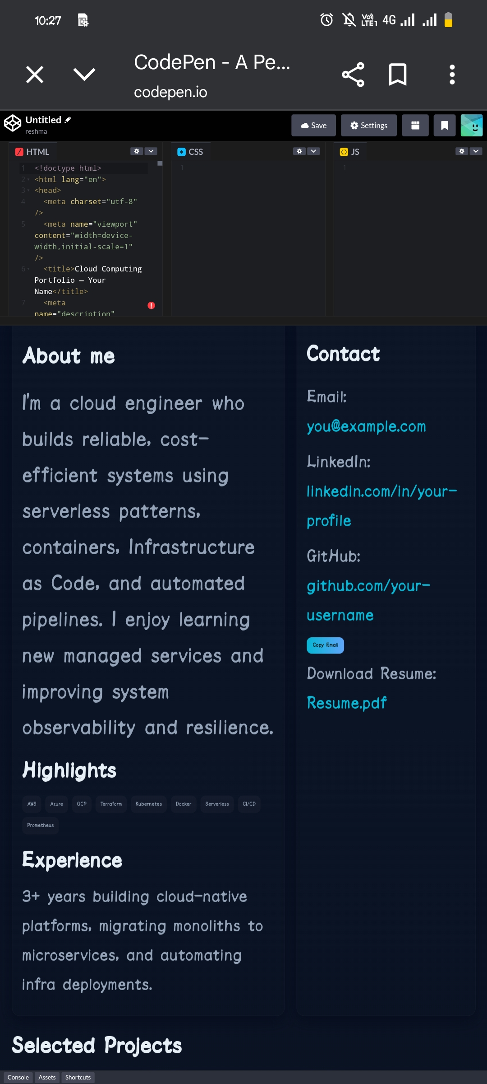
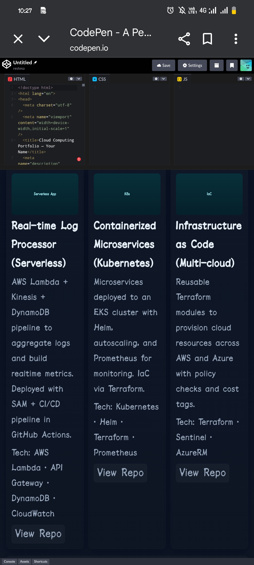

RESULTS AND SCREENSHOTS
3/21/2024 Annual Review
10

Slide 11
CONCLUSION
Cloud computing provides scalable, cost-efficient, and secure solutions for storing data, running applications, and managing resources. It enhances flexibility, supports innovation, and ensures high availability, making it essential for modern businesses and users.
11

